Slide 1
Enhancing copies in the Core of Relational Databases
December 13th, 2022

Slide 2
01 – Previous meeting wrap up
02 – Task completion
03 – Current status
04 – Next steps

Slide 3
01
Previous meeting wrap up

Slide 4
Previous meeting comments
UCI datasets completion
Provisional performance plots

Slide 5
03
Current status

Slide 6
Current Status
01
Automatic regularization term
02
Revisiting spirals with automatic λ
03
UCI analysis

Slide 7
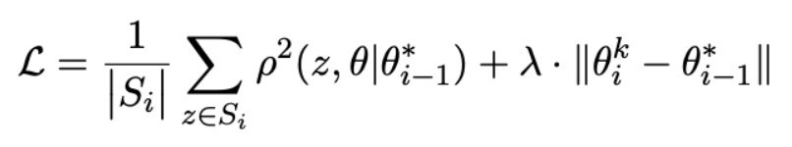
Custom loss function
Uncertainty
Memory
Dropping threshold (ρ)
Long term memory (λ)

Slide 8
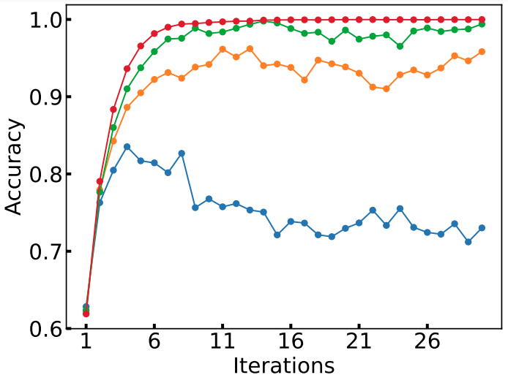
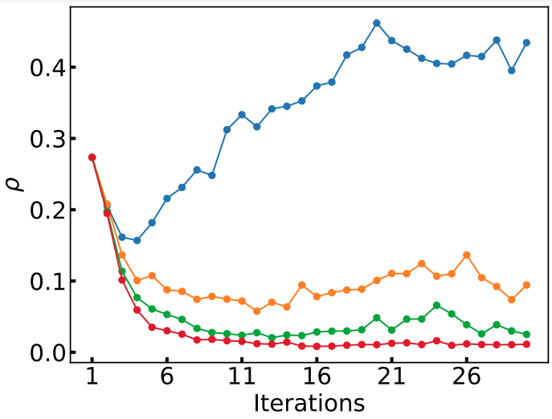
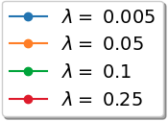
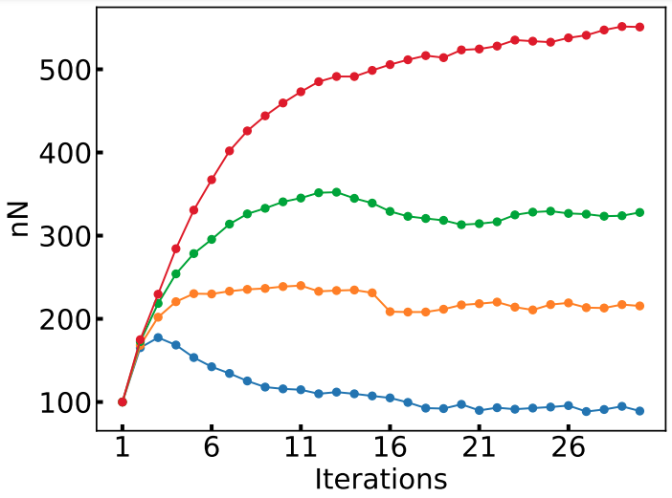
Testing different λ with a single ρ
Spirals. ρ = 1e-8
Good λs
Objective -> constant number of points
λ depends on the ρ, number of points, dataset complexity, …
“The best” λ is case based

Slide 9
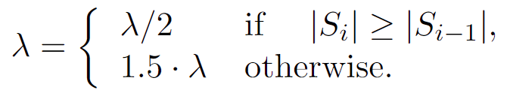
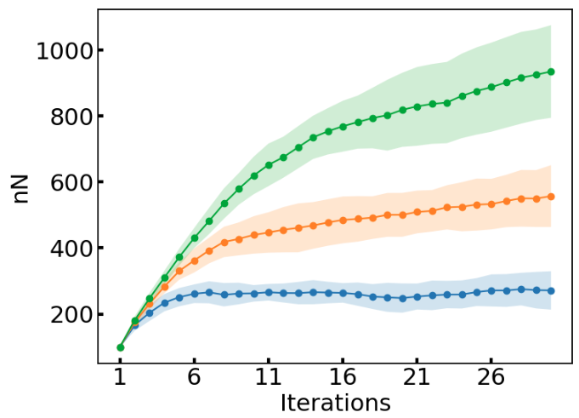
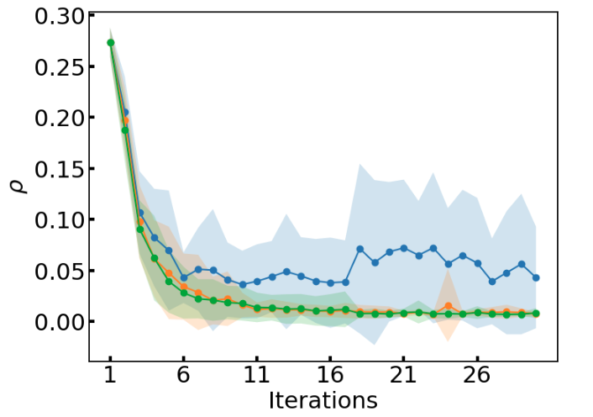
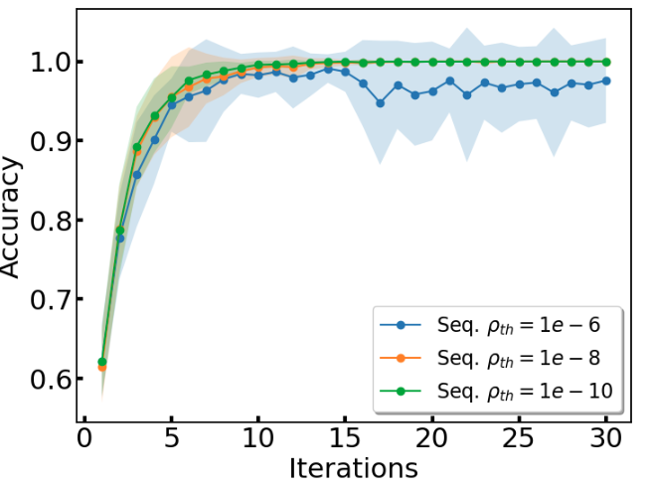
Forcing a constant number of points
Automatic approach:
λ will converge to a small value (like an adaptive learning rate)
The own learning process controls the λ value
No hyperparameter tunning (we only fix ρ)
Results are equivalent (or better) than using fixed λs

Slide 10
Current Status
01
Automatic regularization term
02
Revisiting spirals with automatic λ
03
UCI analysis

Slide 11
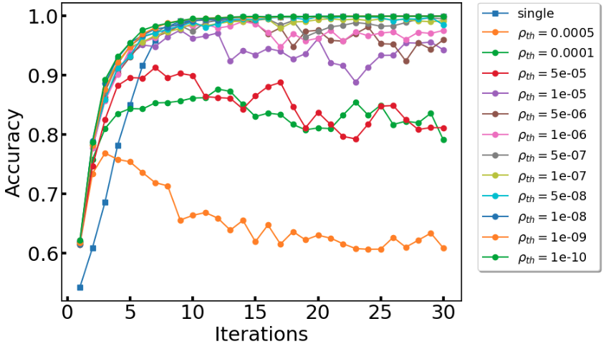
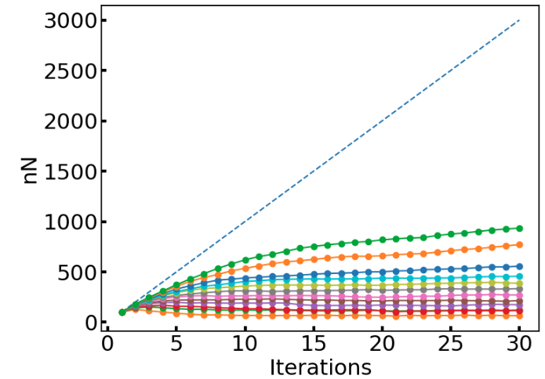
Complete analysis for spirals
AUC_{acc} is used to compare the convergence speed
Memory efficiency is defined respect to the single pass
We assume single pass has no memory efficiency, so sequential pass efficiency is measured as 1-AUC_{nN}/AUC_{single}

Slide 12
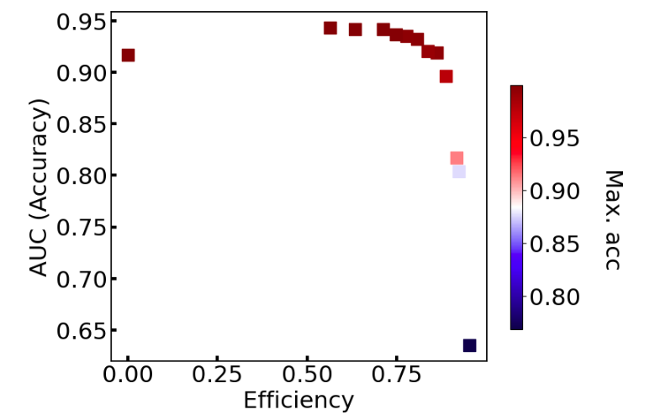
Complete analysis for spirals
Single pass has large accuracy, converges fast, but it’s inefficient (3,000 points)
Different ρ values provide different learning settings (trade-off of speed, accuracy and memory).
We choose the best in accuracy and the best in efficiency (acc > acc_{single}* 0.95)
Now, we use this approach to all the UCI databases

Slide 13
Current Status
01
Automatic regularization term
02
Revisiting spirals with automatic λ
03
UCI analysis

Slide 14
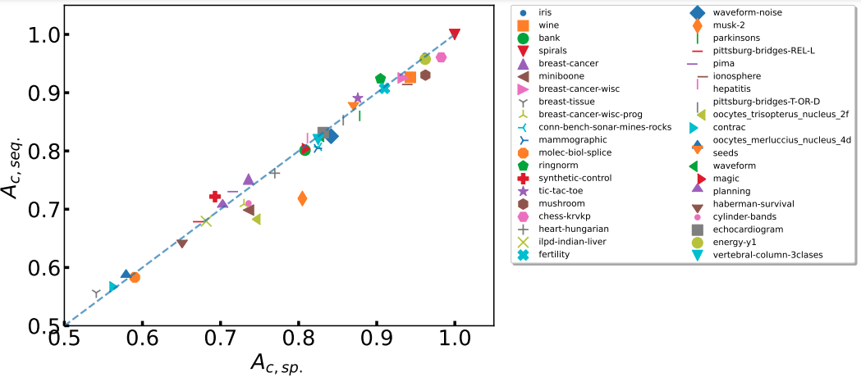
UCI datasets
Relation between accuracy with the single pass and the sequential approach

Slide 15
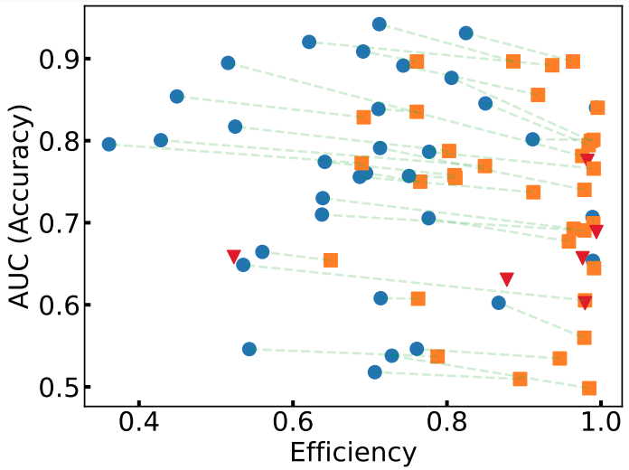
UCI datasets
Blue (largest accuracy), orange (largest efficiency with acc > acc_{single}* 0.95)
The green line is a linear fit of all the intermediate stages that we can achieve only tuning the drooping threshold
Red marks corresponds to the datasets the most efficient and the largest accuracy settings are the same.

Slide 16
04
Next Steps

Slide 17
Next Steps
01
Arxiv of the paper
02
Financial use case. We already have a database choose

